Slide 1

Sprint 5 Presentation
Golf Player Time Management
Adam Horle, Alyssa Beeker, Bailey Carlin, Daniel Teel, Elijah Hunt

Slide 2
Player Overview
Data tables that observe and read firebase
Pagination, sortable headers
Default sort by time descending
Player Requests
Shows all current requests
Player, time, location, request
Firebase cron function to clear the days’ request each night after close
Dismiss action button when a request has been completed
Active Games
Shows current games
Group leader, location, time
A Firebase function clears all requests and games each morning at 2:05 AM
Commented out in the demo so that there’s data populated

Slide 3
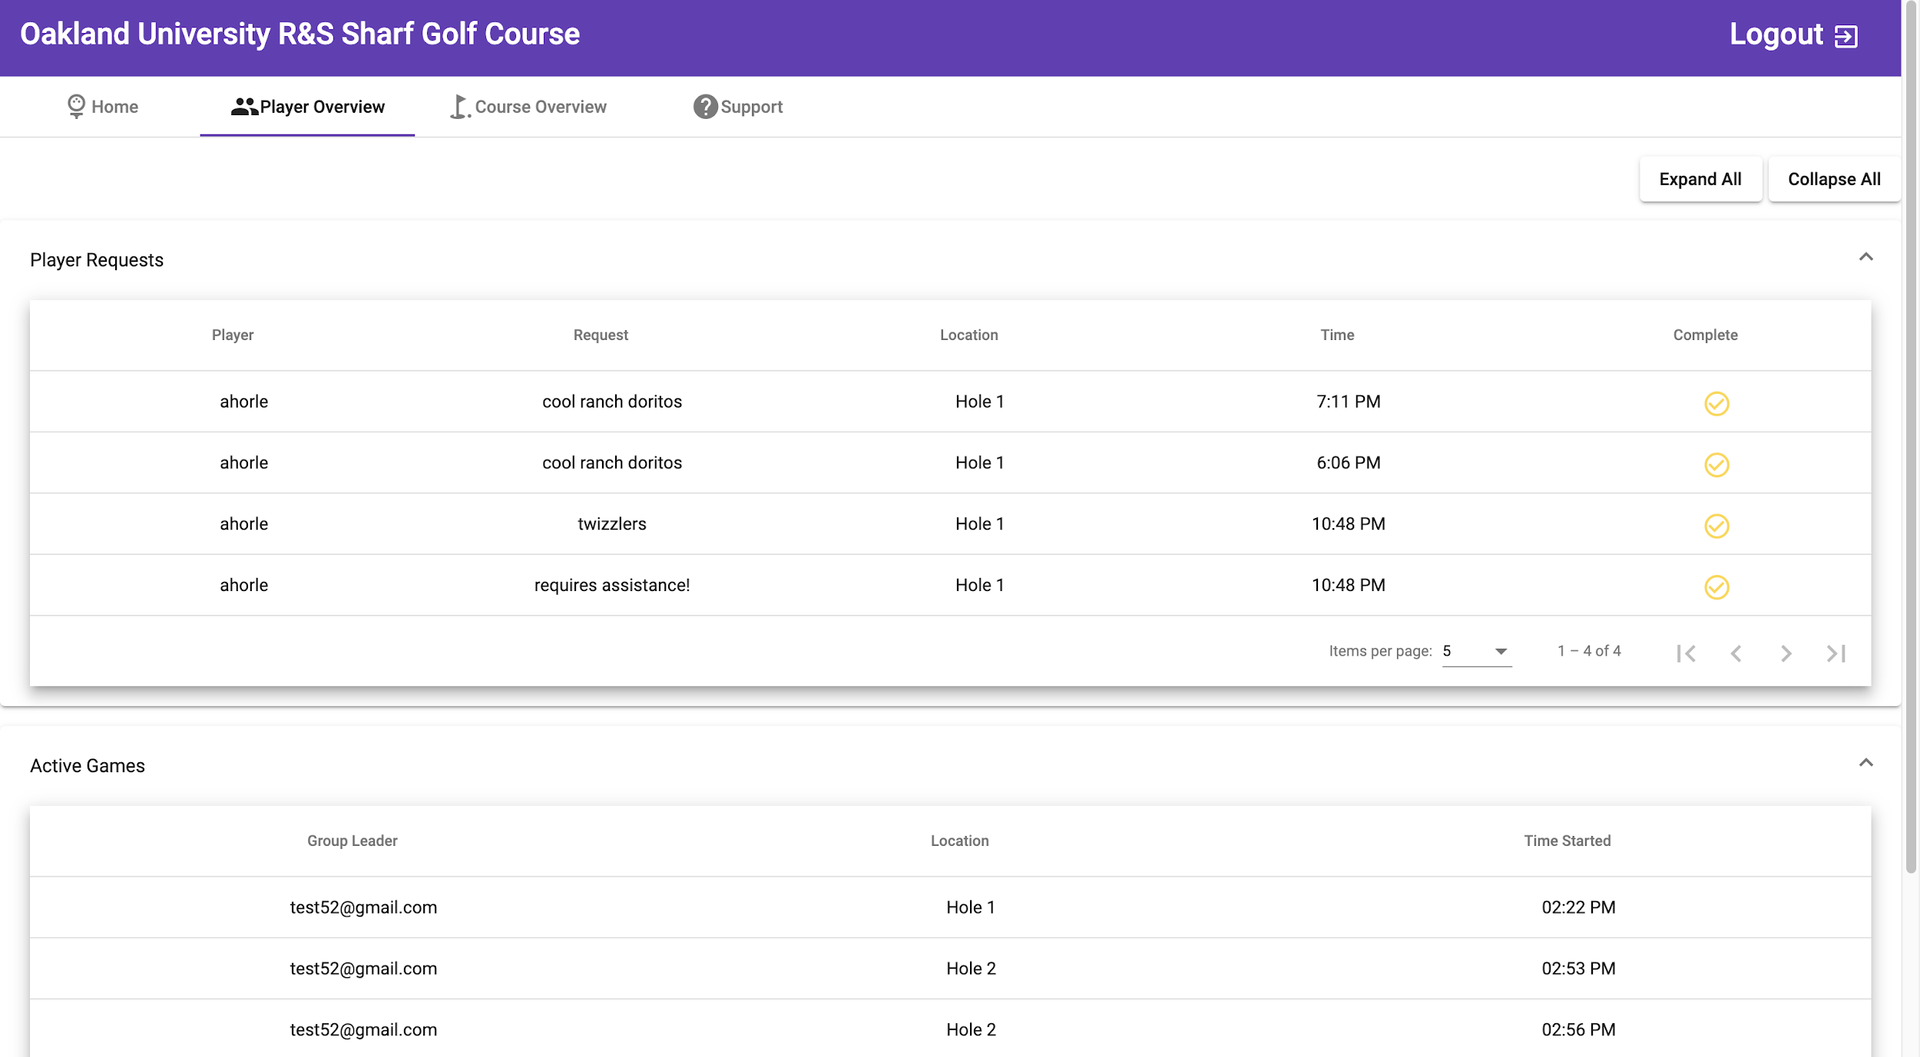

Slide 4
Hole Marker
Admins can now mark the hole location
Changed the color of the polyline and polyfill for better readability
Finalized the map portion
Hard cut off after 1 pin is dropped and 1 polygon is drawn
Undo button clears polygon and gives user control to draw again (hides/shows control overlay)
Added in an event listener that I forgot about last sprint

Slide 5
Mobile App Sprint 5
Updated game setup.
Manage group
Select difficulty
Updated UI
Updated GameActivity
Fixed bugs
Marked holes on the course.
Players select a spot on the course and it displays the distance from the hole.
Updated UI.

Slide 6
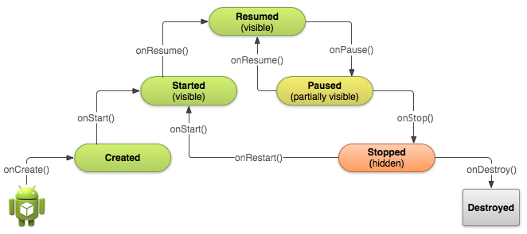
Mobile App Roadblocks
Saving the activity state when going back and forth between activities.
In game setup this was achieved by using bundles.
The GameActivity is still a working progress.

Slide 7
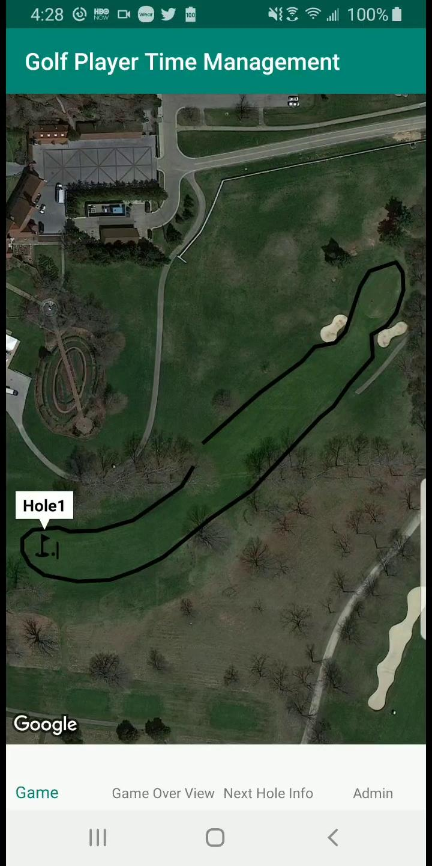
Demo
https://youtu.be/xK5v9pppXKg

Slide 8
Mobile Requests Revamped (Now with Assistance)
Players can now ask for different things in a request
Food, drinks, more golf balls and assistance
Tracks player’s current geographical location at time of request
Sends the time, player, hole number, type of request and location to firebase

Slide 9
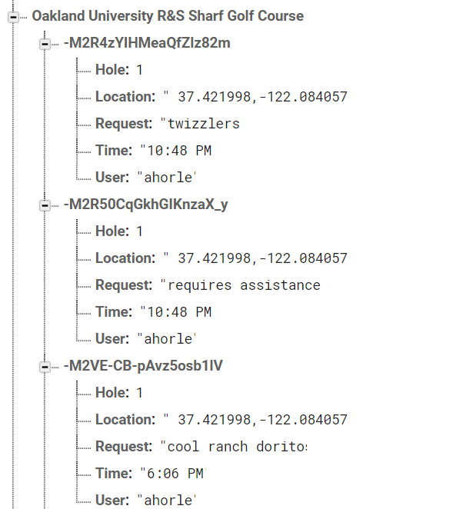
Mobile Requests/Assistance Demo
https://youtu.be/-29fivlTDFA

Slide 10
Mobile Requests/Assistance Tests
Configuring requests to be sent via a hashmap ✔
Reconfiguring the way requests are formatted
Getting rid of separate assist child and with that the type, eg. Food-> Doritos ✔
Getting the chronometer (timer) to work at a specified time interval ✔
Issue with adding geolocation
Didn’t like how one child had a “/” in their name, I didn’t know what this was about since it worked just fine before this feature was added, but it works now ✔

Slide 11
Final Sprint User Stories and UI/UX

Slide 12
Next Sprint User Stories UI/UX
As a player I would like a clean, simple looking and easy to read UI
As a player I want a unified color palette that could fit golf
As an admin/developer I would a clean and simple UI so more users enjoy and use the app
As a player I do not want too many buttons that perform very different functions on the same screen incase I press the wrong button
As an admin I don’t want that many buttons with different functions on the same screen so there is less user error

Slide 13
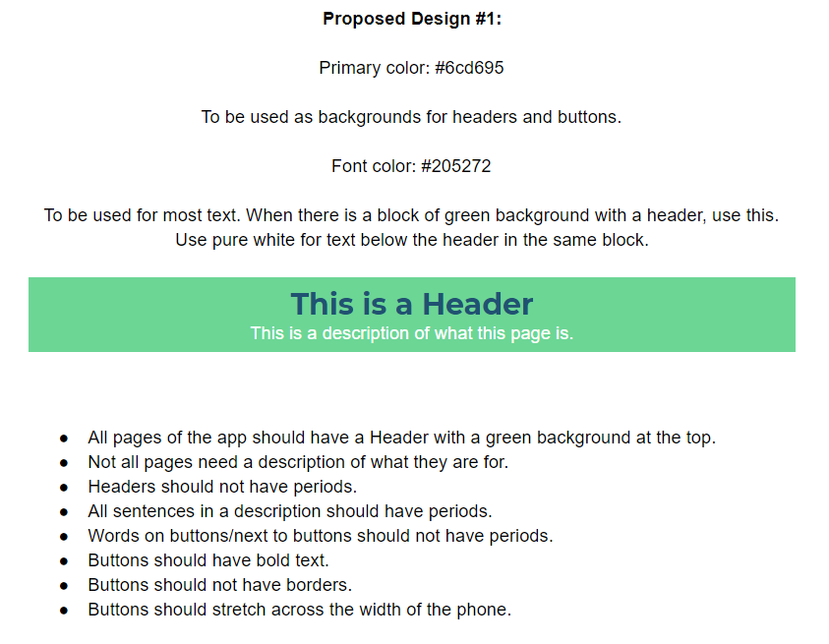
Design Proposals
Team working on multiple proposed designs to find the best looking interface

Slide 14
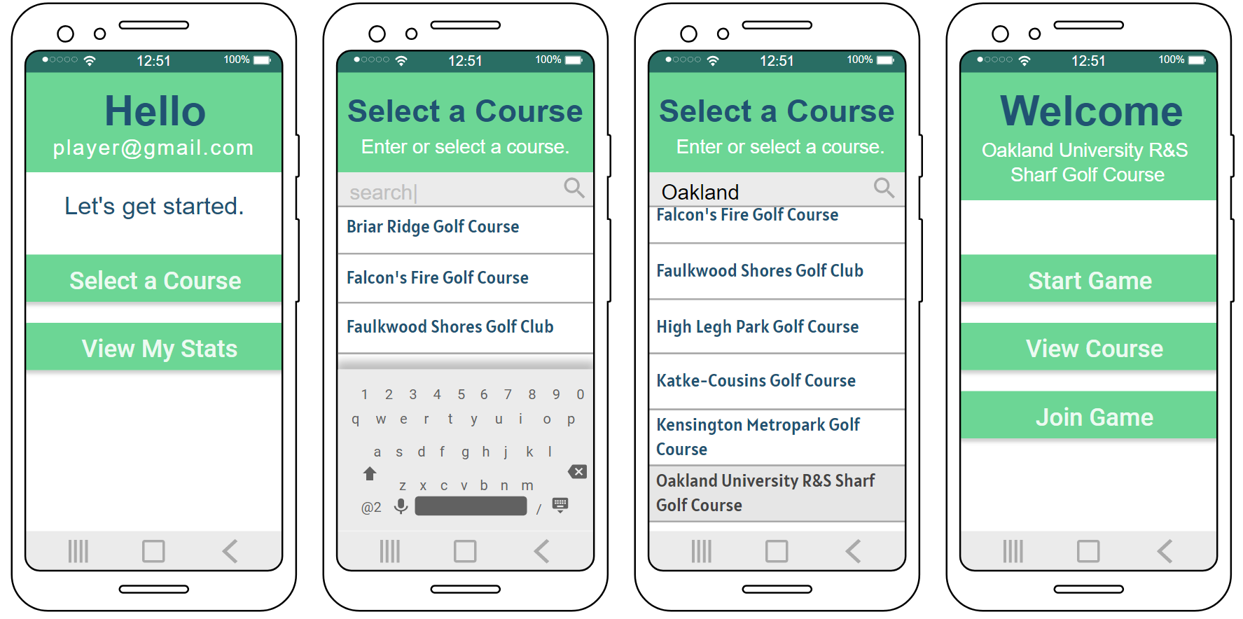

Slide 15
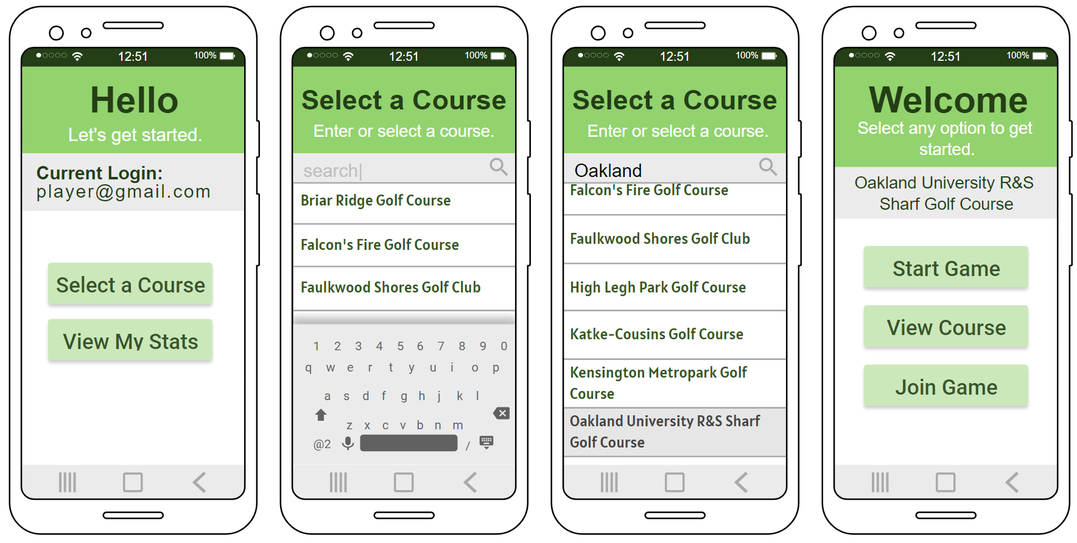

Slide 16
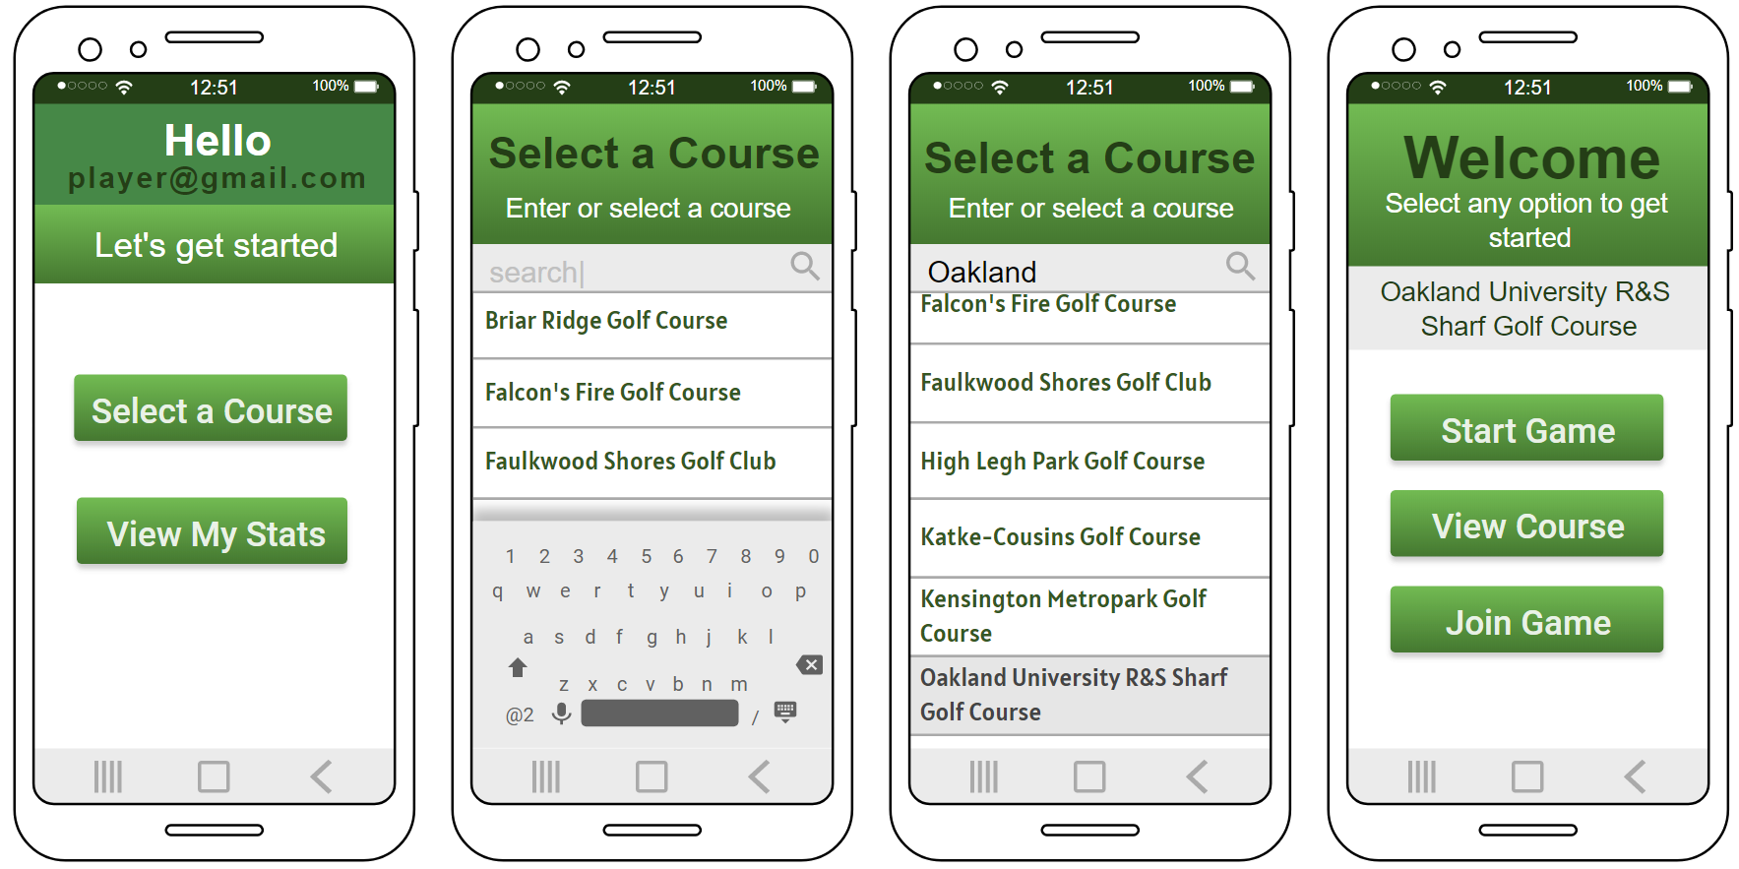

Slide 17

Challenges Encountered
Scheduling conflicts due to COVID-19
Lots of adjustments
Saving android activity states.
Android updates causing the build to not work, had to clean and rebuild
Communication

Slide 18

Sprint 6 Objectives
Continue to churn out documentation
QA for both apps
Squash any lingering bugs
Web App:
UI improvements (loading bars, animations, etc.)
Flesh out Support Page to include all relevant walkthroughs
Predict wait times
Mobile App:
UI improvements
More functionality
Test App on golf course

Slide 19
Demo Link
https://golf-player-time-management.firebaseapp.com

Slide 20
Questions

